Slide 1
Direct Cooling Technique
01 / 21 / 2026
Spray Cooling

Slide 2
Control Strategy

Slide 3
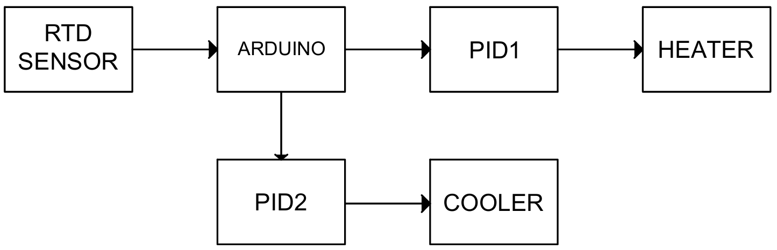
Option 1: Automated cooling/heating
PID controller for both heating element / cooling element
Fig. 1. Block diagram for automated heating and cooling elements

Slide 4
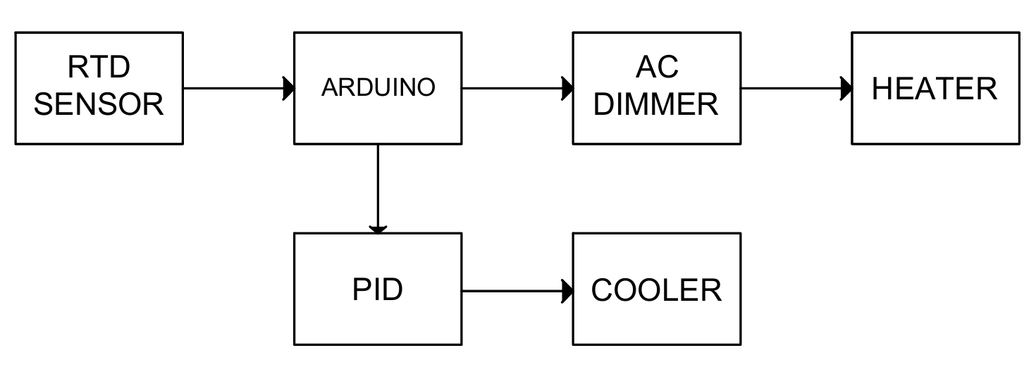
Option 2: Manual heating / Automated cooling
PID controller for cooling element / Manual open-loop for heating element
Fig. 2. Block diagram for manual heating and auto mated cooling elements

Slide 5
Comparision
Options | Pros | Cons
Option 1 | Precise temperature control in both directions Faster response to setpoint change (don’t need manual tuning) Better disturbance rejection | More complex PID tuning (2 PIDs) Requires additional control logic to prevent simultaneous cooling/heating Higher computational overhead Potential for instability using 1 Arduino for both actuators
Option 2 | Simpler implementation in short-time No heating / cooling conflict Can easily deactivate/activate separated PID controllers if needed to further studies Easier to troubleshoot Lower computational requirement (less load on Arduino) | Manual calibration of heating manual to get to set temp through power output Less precise at elevated temperature
Table. 1. Comparison between 2 proposed options

Slide 6
Implementation

Slide 7
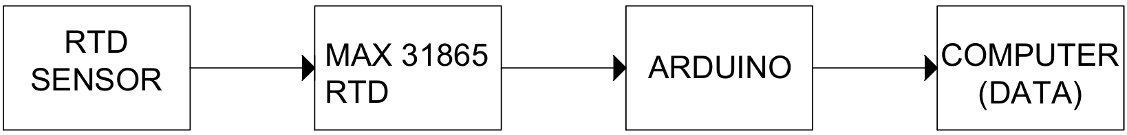
1) RTD set-up
Fig. 3. Block diagram for RTD sensor w/o DAQ
w/o DAQ |  | With DAQ
Lower cost Compact Faster prototype Lower power consumption Easier data log | Manual calibration Scaling difficulty Hard to diagnose | High accuracy Noise rejection Automatic linearization Easy scaling | LABVIEW compatible Built-in diagnostic Higher cost
Table. 1. Comparison reading RTD sensor w/ and w/o DAQ

Slide 8
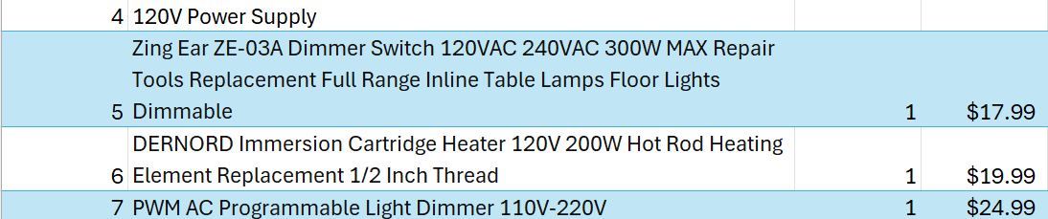
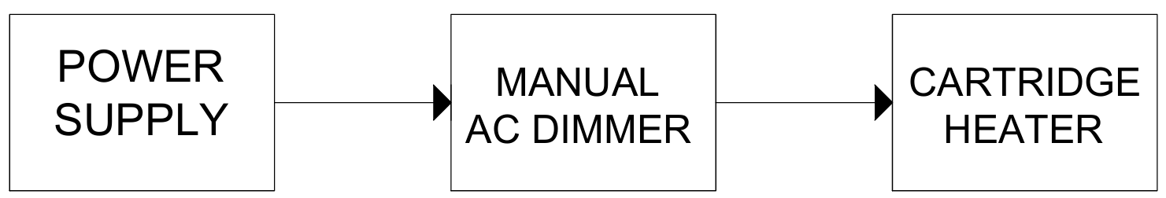
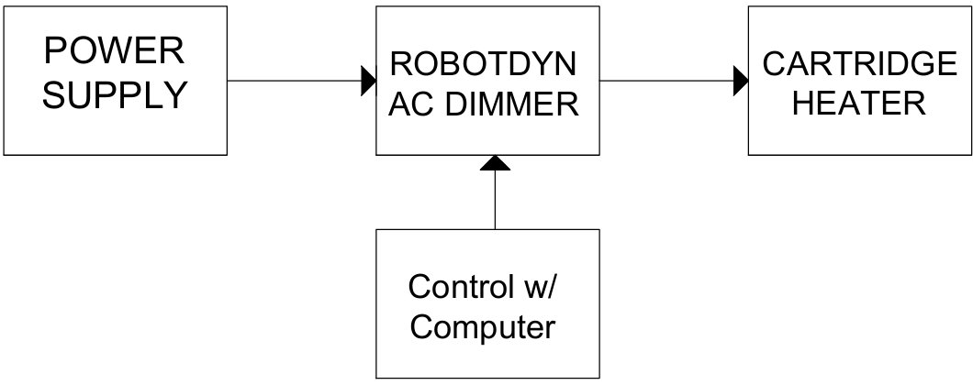
2) Heating Element
Controller
Fig. 4. Block diagram for heating element w/ manual dimmer
Fig. 5. Block diagram for heating element w/ digital dimmer

Slide 9
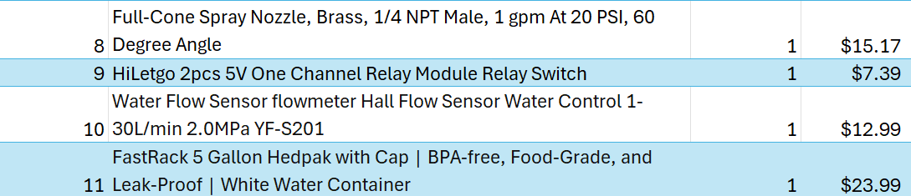
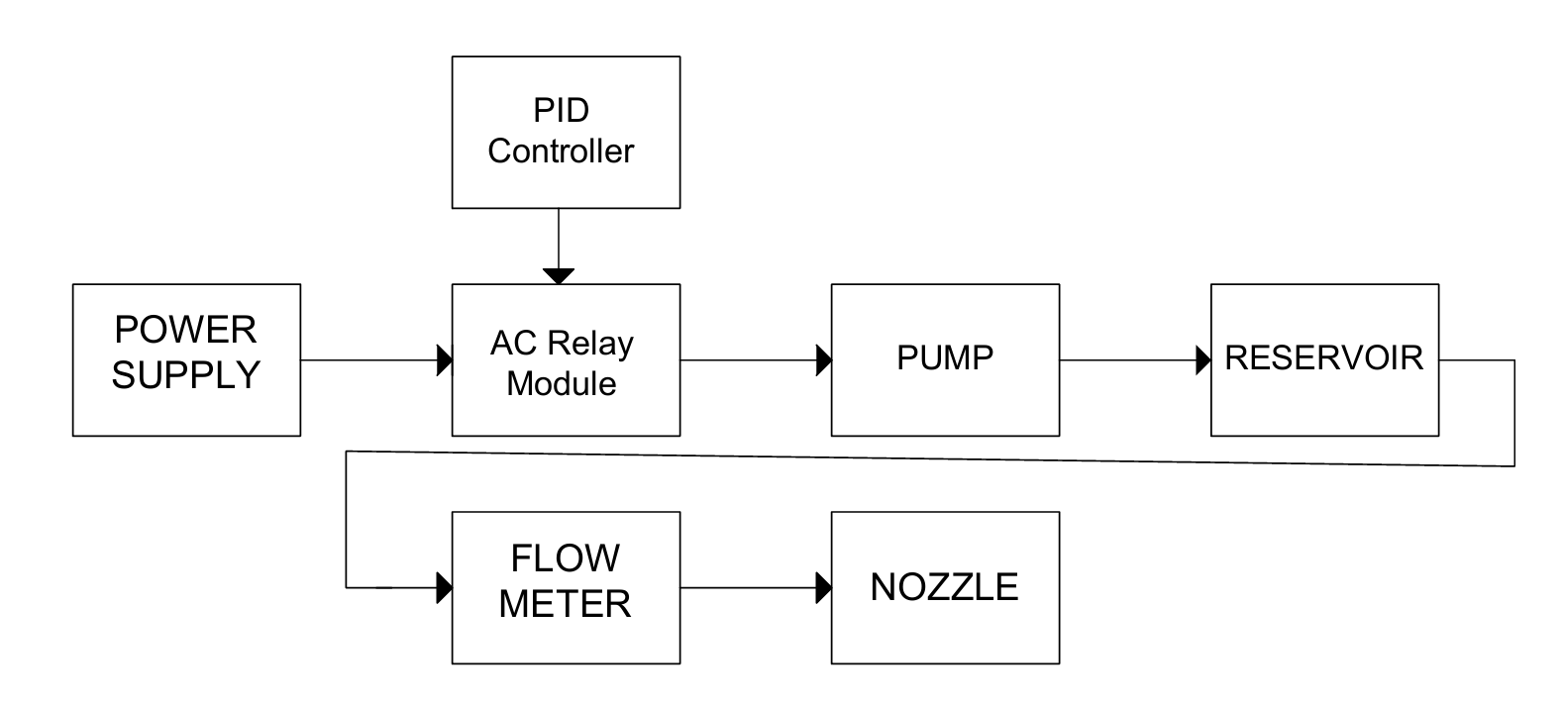
3) Cooling Element
Controller
Fig. 6. Block diagram for cooling element w/ digital dimmer

Slide 10
Control Systems

Slide 11
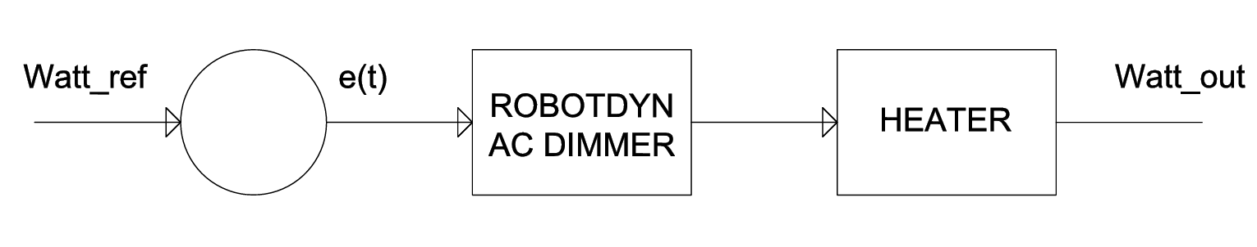
1) Open-loop for heating element
Fig. 7. Open-loop control diagram for heater

Slide 12
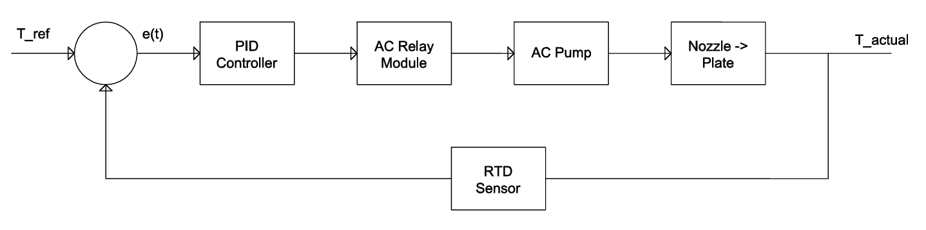
2) Close-loop for cooling element
Fig. 8. Close-loop control diagram for cooling element

Slide 13
Next Steps

Slide 14
Rough Timeline
Week (02/09-15): CAD Model for spray chamber and test rig (need additional verification from Bill Mouron or Kai, finalize BOM and start ordering (if in time)
Week (02/16-22): Electrical schematic for hardware, hardware arrives
Week (02/23 – 03/01): 3D prints nozzle fixture, start looking for stock to manufacture
Week (03/02 – 03/08): Midterm deliverable
Midterm Deliverable (03/08/2026): PPT presentation from the start (including abstract, project’s vision)
Week (03/09 – 03/15): Start assembly test rig, start construct coding for PIDs
Week (03/16 – 03/23): Continue assembling test rig, if set up on time, tune PIDs

Slide 15
Rough Timeline (cont.)
Week (03/23 – 03/29): If test rig is completed and microcontrollers are fine-tuned, setting up testing procedures
Week (03/30 – 04/05): Run test rig under various load (plot flow rate vs temp)
Week (04/06-04/12): Implement power meter PZEM-004T to read power consumption of pump (plot power w/ controller – without controller against temp)
Final Presentation: Abstract, Preparation, Diagram, Part Sorting, Assembling, Tuning, Project’s Vision, Future Improvements, Future Studies using the test rig (MPC & ML controller, two phases fluid, nozzle orientation [automated], neural network PID for dynamic environment, etc…)

